Slide 1


Slide 2
Food Energy: How many acres of potatoes does a society need?
Nathan Moore (WSU)
What is energy?

Slide 3
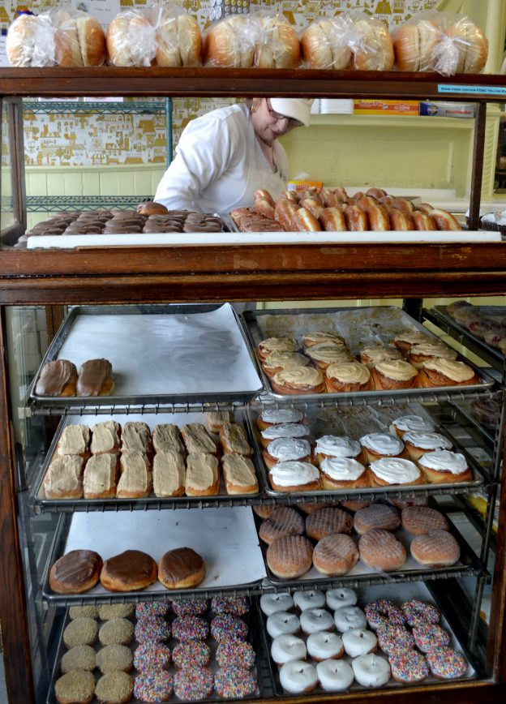
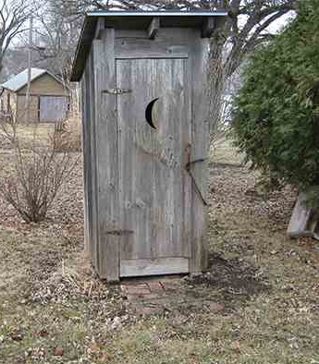

Slide 4
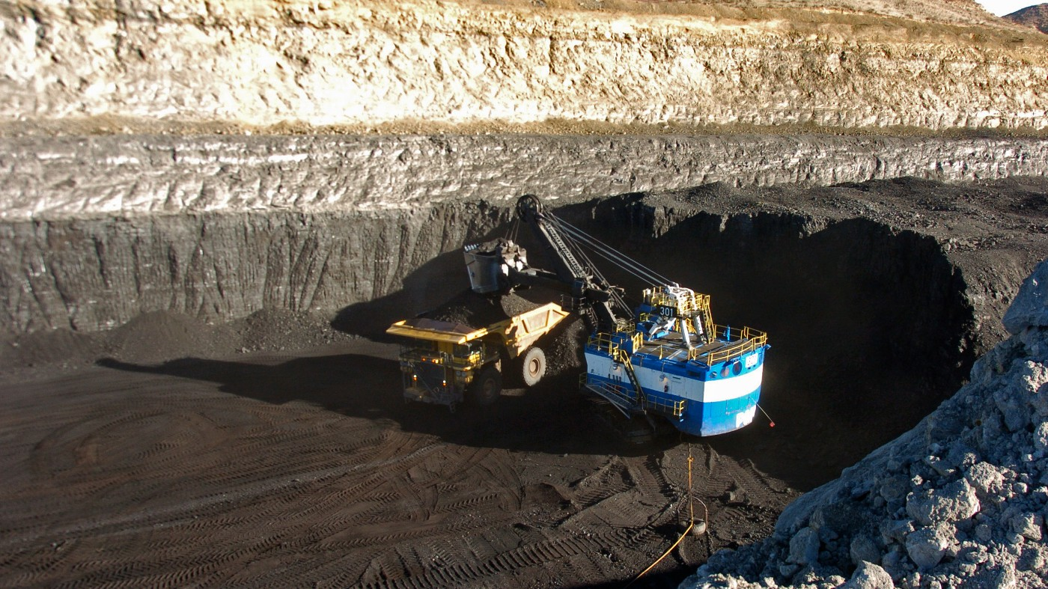
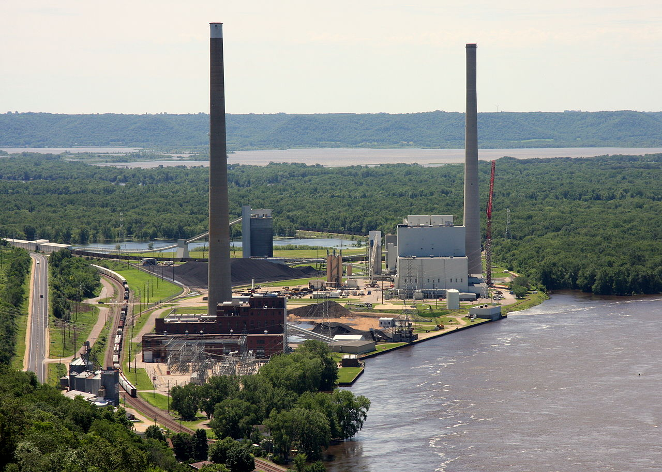
Notes:
https://thehill.com/opinion/energy-environment/3884019-want-to-save-the-climate-buy-a-coal-mine/

Slide 5

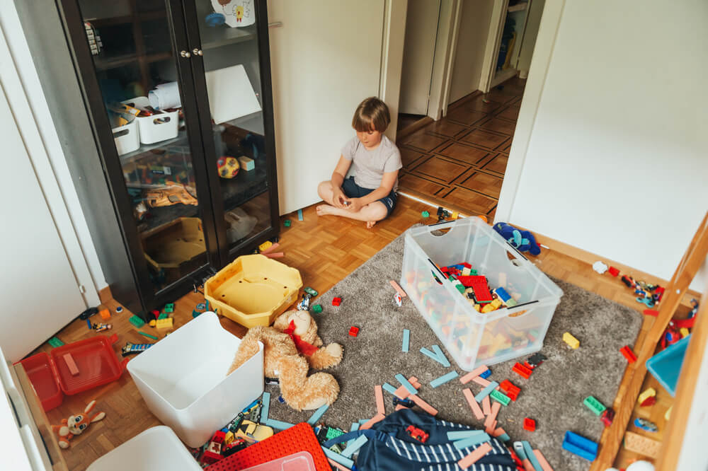

Slide 6
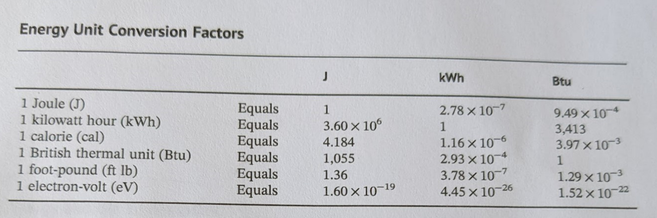
Electric Company
Physics
Hospital Dietician
HVAC
Semiconductors+ Chemistry
Gasoline engines

Slide 7
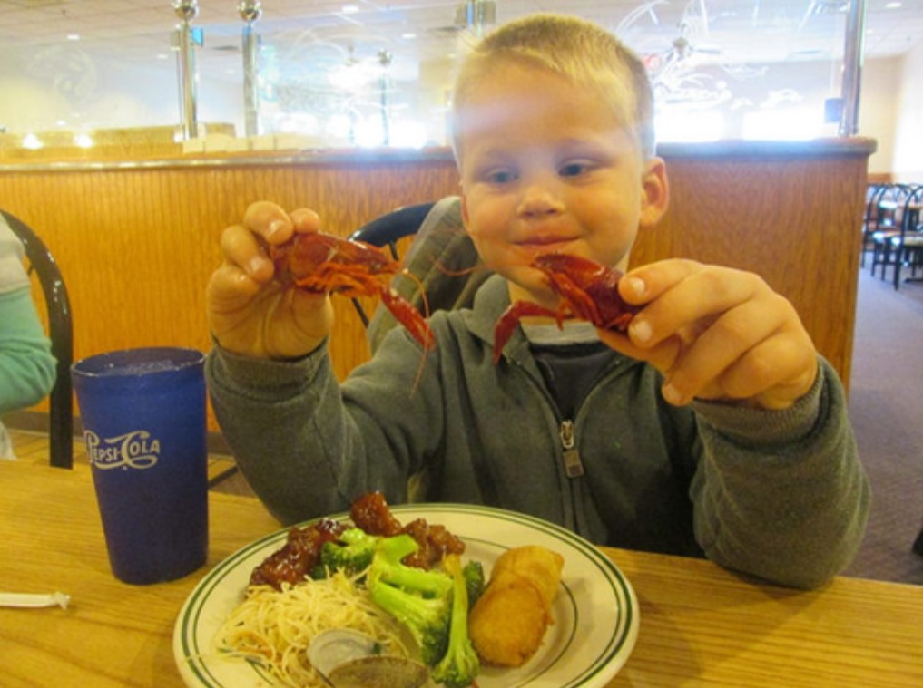
1 kilocalorie (kcal) heats
1 kg Water by 1deg C
Or 1 calorie heats
1 gram of water 1deg C
1 kcal=1 Calorie = 1000 calories
An 85kg college student eats 3000kcals and his body burns it all, immediately…

Slide 8

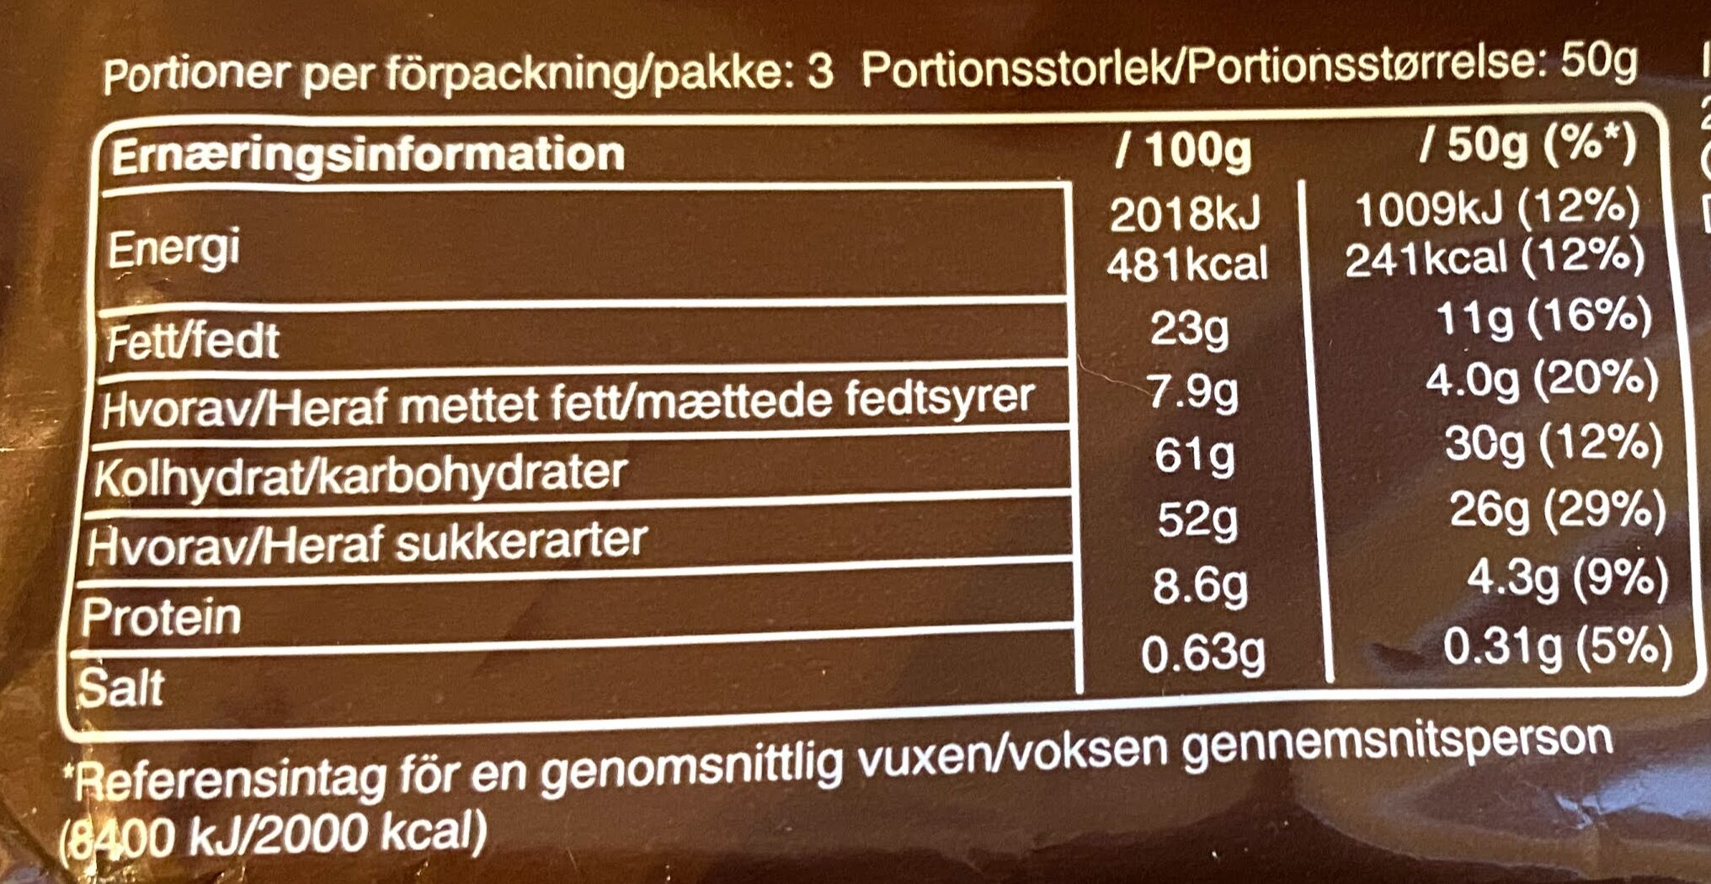
1 kilocalorie (kcal) heats
1 kg Water by 1deg C
Or 1 calorie heats
1 gram of water 1deg C
1 kcal = 1 Calorie = 1000calories
Notes:
https://world.openfoodfacts.org/product/5000159429153/snickers-mars

Slide 9
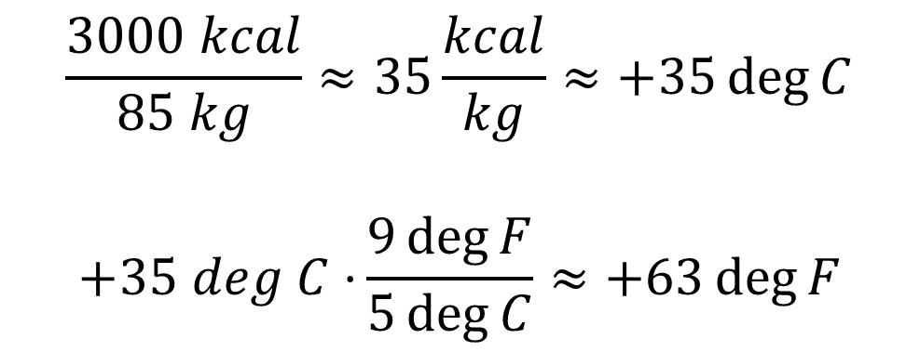
1 kilocalorie (kcal) heats
1 kg Water by 1deg C
An 85kg college student eats 3000kcals and his body burns it all, immediately.
$$\frac{3000 kcal}{85 kg}≈35\frac{kcal}{kg}≈+35\deg{C}$$
$$+35 deg C⋅{\frac{9\deg{F}}{5\deg{C}}≈+63\deg{F}}$$

Slide 10
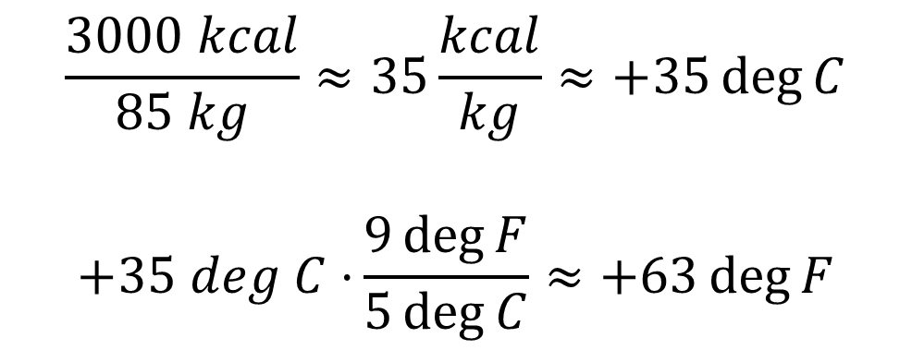
1 kilocalorie (kcal) heats
1 kg Water by 1deg C
An 85kg college student eats 3000kcals and his body burns it all, immediately.
$$\frac{3000 kcal}{85 kg}≈35\frac{kcal}{kg}≈+35\deg{C}$$
$$+35 deg C⋅{\frac{9\deg{F}}{5\deg{C}}≈+63\deg{F}}$$
What’s wrong with this story?
His body temperature rises to … 98.6 + 63 = 162 deg F

Slide 11
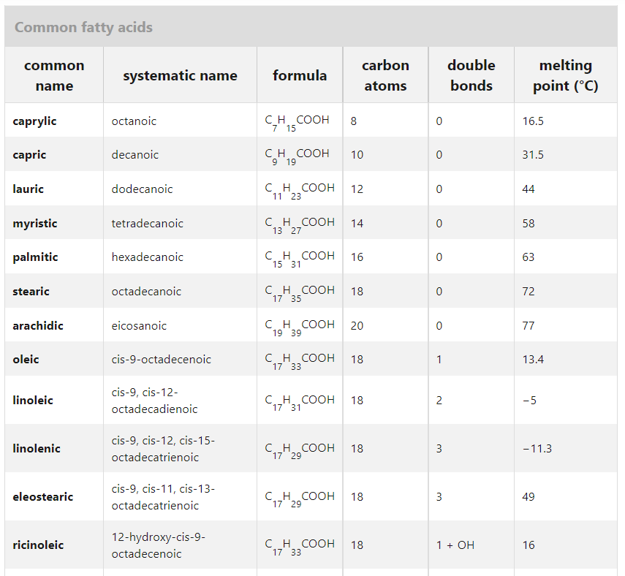
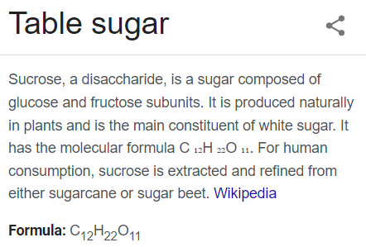
Most food turns into CO2 and H20!
Fat (molecules) we eat

Slide 12
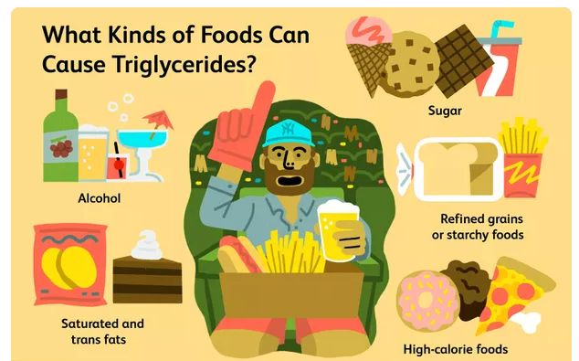
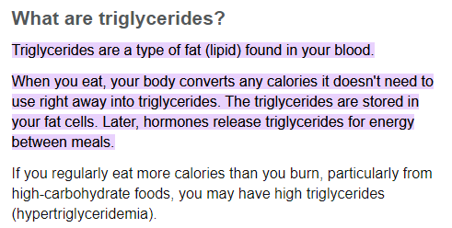
What happens to that food energy?
Force*
distance
Food > Blood Sugar > Fat > Blood Sugar > Muscles > Body heat > Environment
Stomach & gut
Blood
Fat Tissue
Blood
Muscles
Blood Sugar
Fat (Lipids)
Blood Sugar
Environmental heat
Food
Body Heat
Acid + micro-biome
Liver
Muscle (actin)
Sweat, breath
Liver
Notes:
Food > blood sugar > Fat tissue > Sugar > muscles > climb a hill
https://www.mayoclinic.org/diseases-conditions/high-blood-cholesterol/in-depth/triglycerides/art-20048186
https://www.verywellhealth.com/what-foods-cause-high-triglycerides-1087467

Slide 13
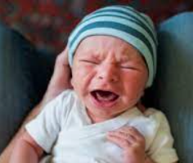
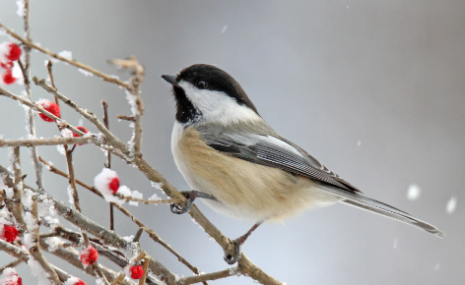
What happens to that food energy?
Force*
distance
Food > Blood Sugar > Fat > Blood Sugar > Muscles > Body heat > Environment
Stomach & gut
Blood
Fat Tissue
Blood
Muscles
Blood Sugar
Fat (Lipids)
Blood Sugar
Environmental heat
Food
Body Heat
Acid + micro-biome
Liver
Muscle (actin)
Sweat, breath
Liver
If you don’t have Fat tissue, how often do you need to eat?
Notes:
Food > blood sugar > Fat tissue > Sugar > muscles > climb a hill
https://www.mayoclinic.org/diseases-conditions/high-blood-cholesterol/in-depth/triglycerides/art-20048186
https://www.verywellhealth.com/what-foods-cause-high-triglycerides-1087467

Slide 14


Slide 15
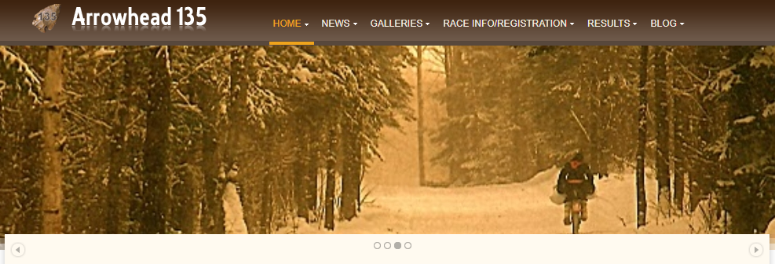
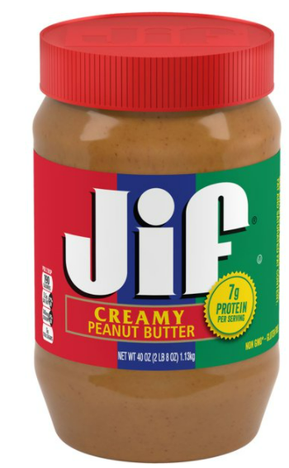
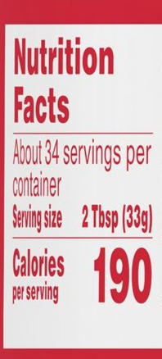
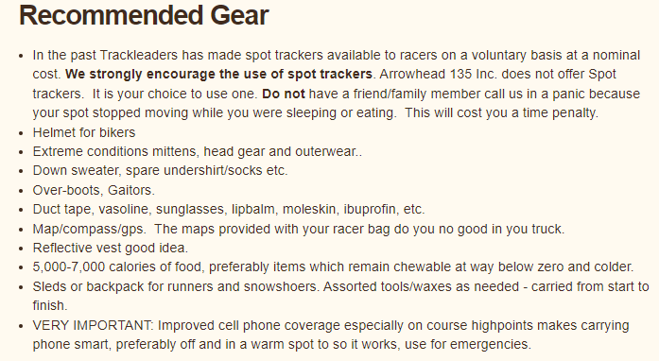
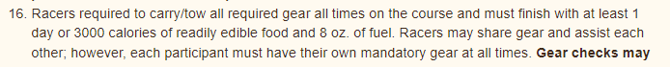
A jar of peanut butter is not a joke!
190kcal * 34 servings ~ 6400kcal
Notes:
International Falls to Tower MN. 135 miles, Jan 31-Feb 2: 7am Monday to 7pm Wednesday
http://www.arrowheadultra.com/

Slide 16
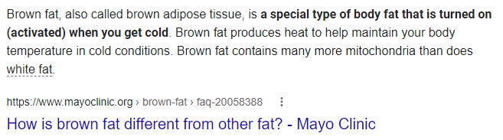
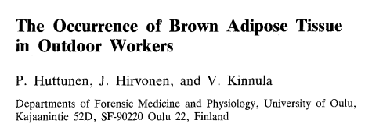
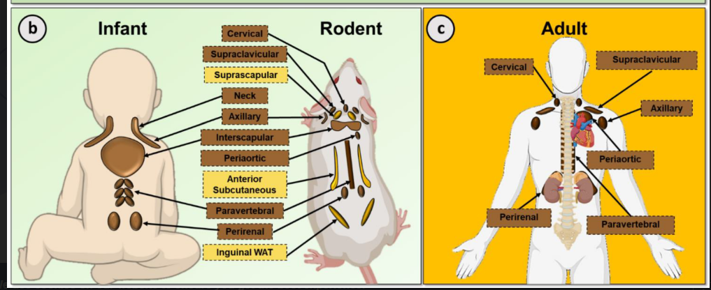

Slide 17
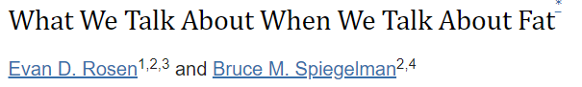
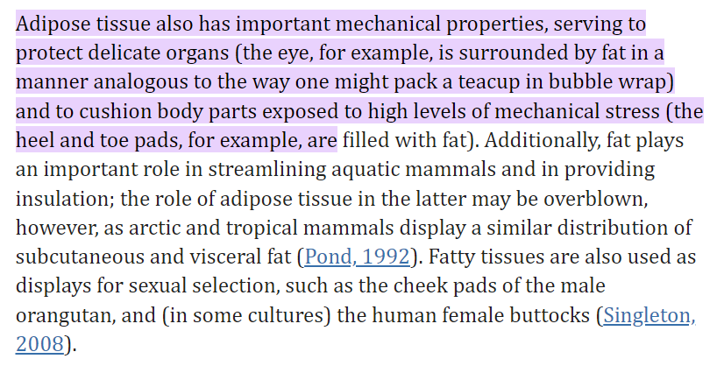


Slide 18
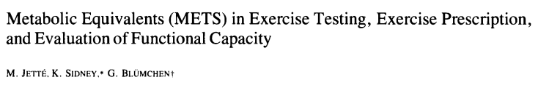
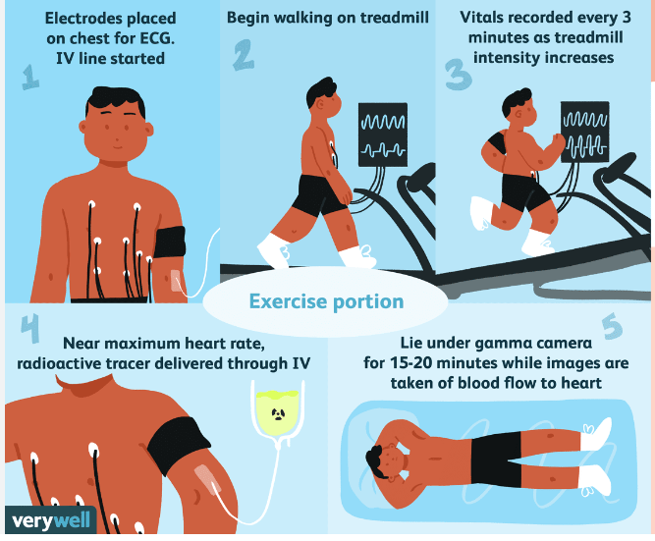
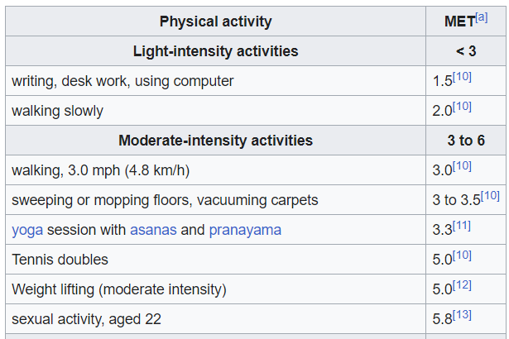

$$1MET=\frac{1 kcal}{kg⋅hour}=\frac{85kcal}{85kg⋅hour}=\frac{2040kcal}{85kg⋅day}$$

Slide 19
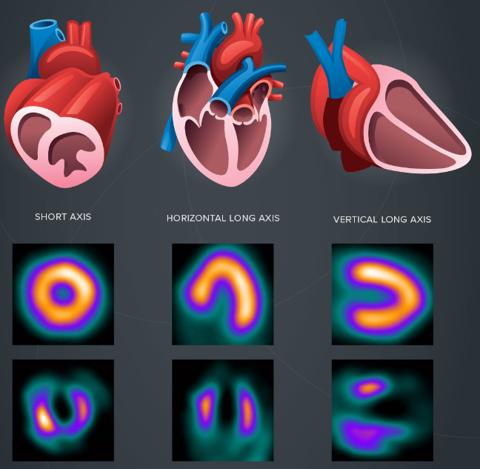

Slide 20
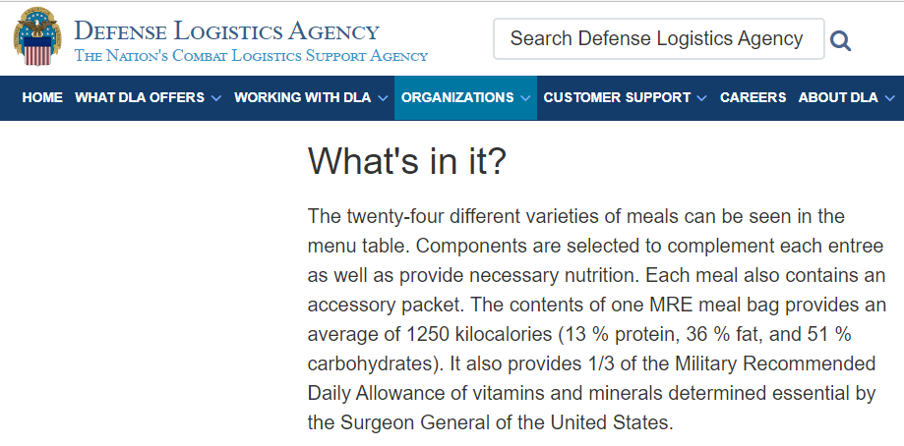
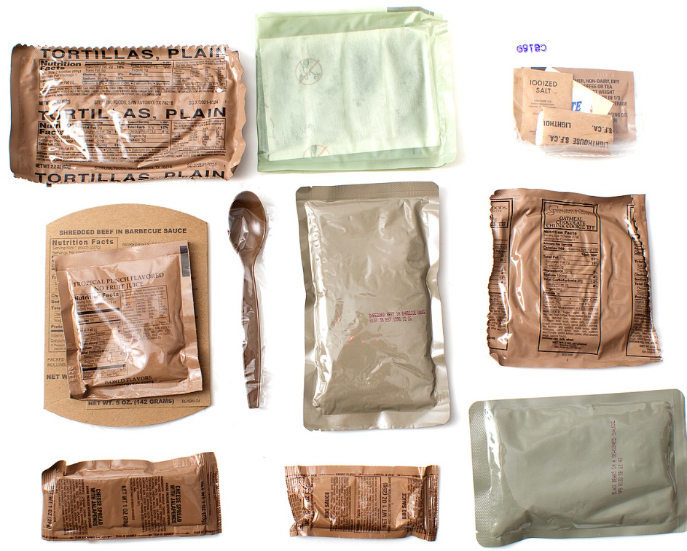
Where did 3000kcal/day come from?

Slide 21
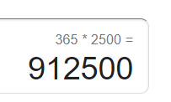
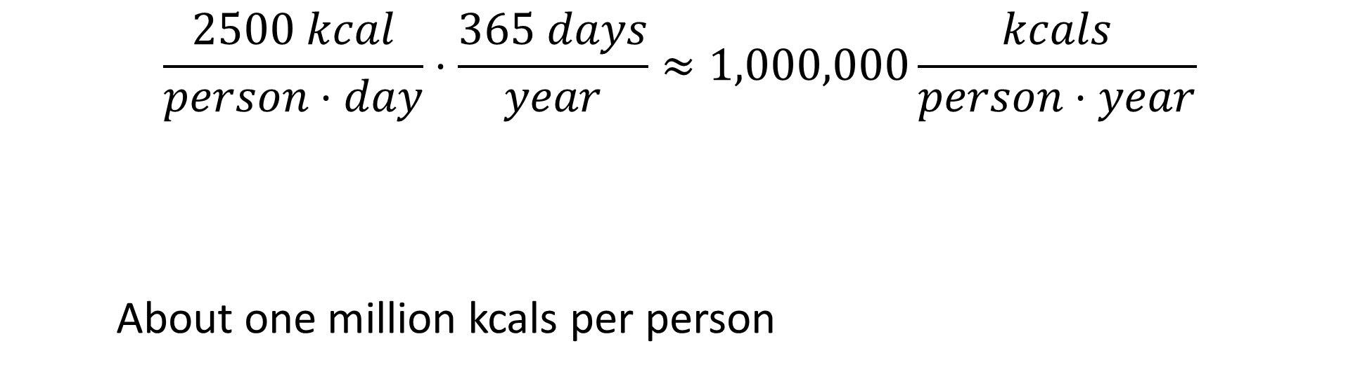
Each year?
$$\frac{2500 kcal}{person⋅day}⋅\frac{365 days}{year}≈1,000,000\frac{kcals}{person⋅year}$$
About one million kcals per person

Slide 22
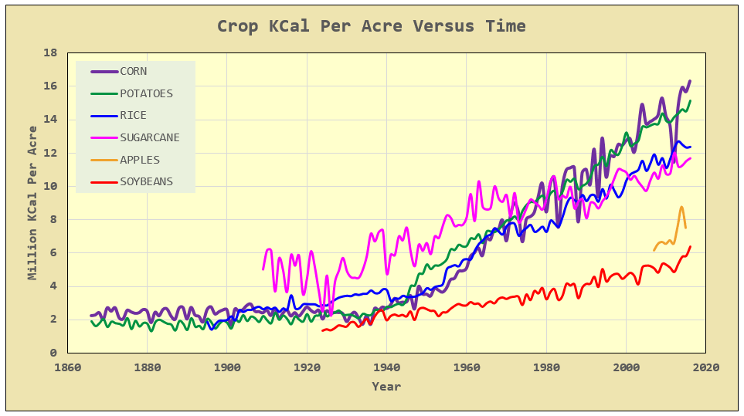
How do we get those kcals?
People fed per acre
Notes:
Via math encounters blog, USDA data

Slide 23
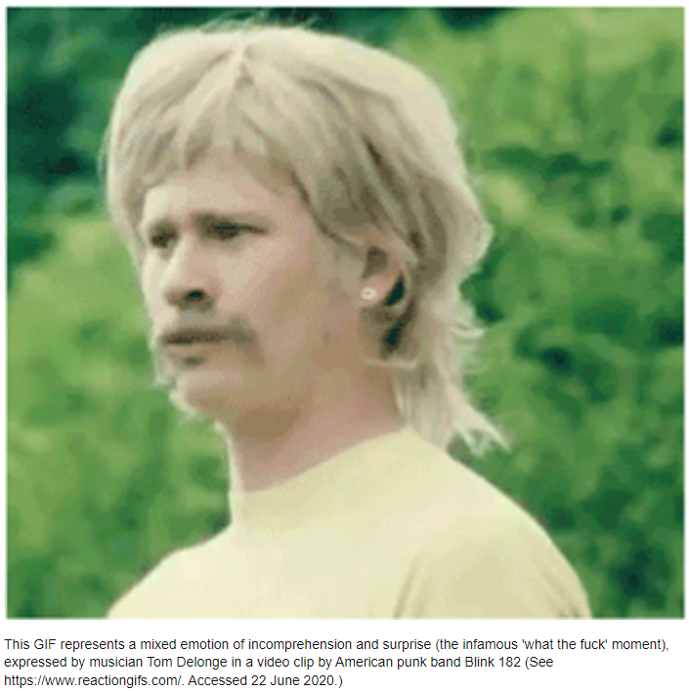
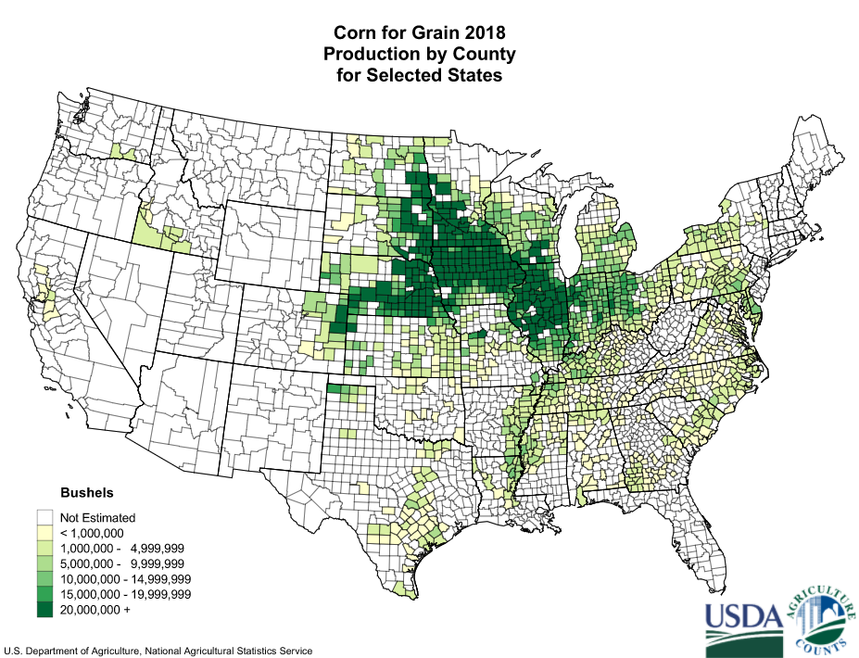
@15M kcal/acre: if we only fed the US corn, how much area would be needed?
Iowa, 36M acres
So why do we grow so much corn?
Notes:
https://en.wikipedia.org/wiki/Corn_Belt 330M M kcals means about 22M acres
Total area: Iowa 36M acres, IL 37M acres

Slide 24
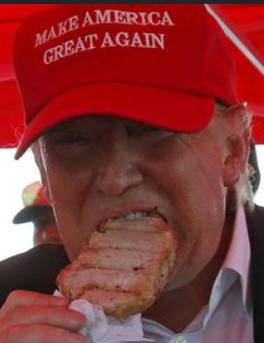
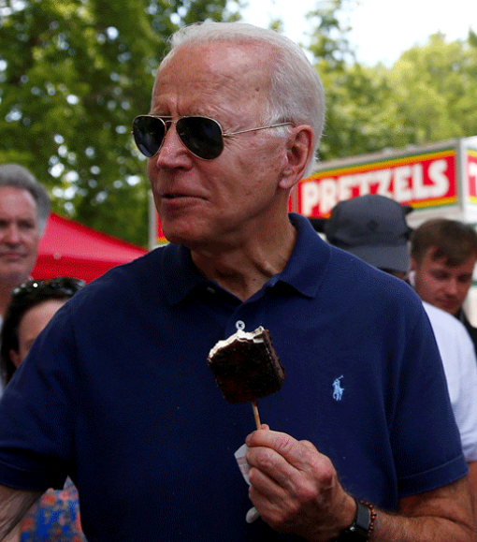
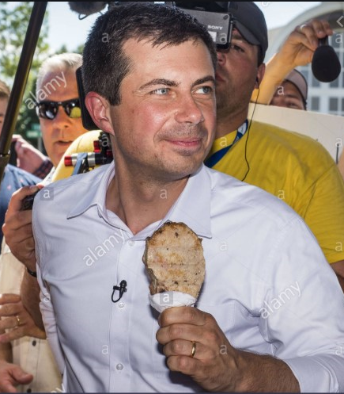
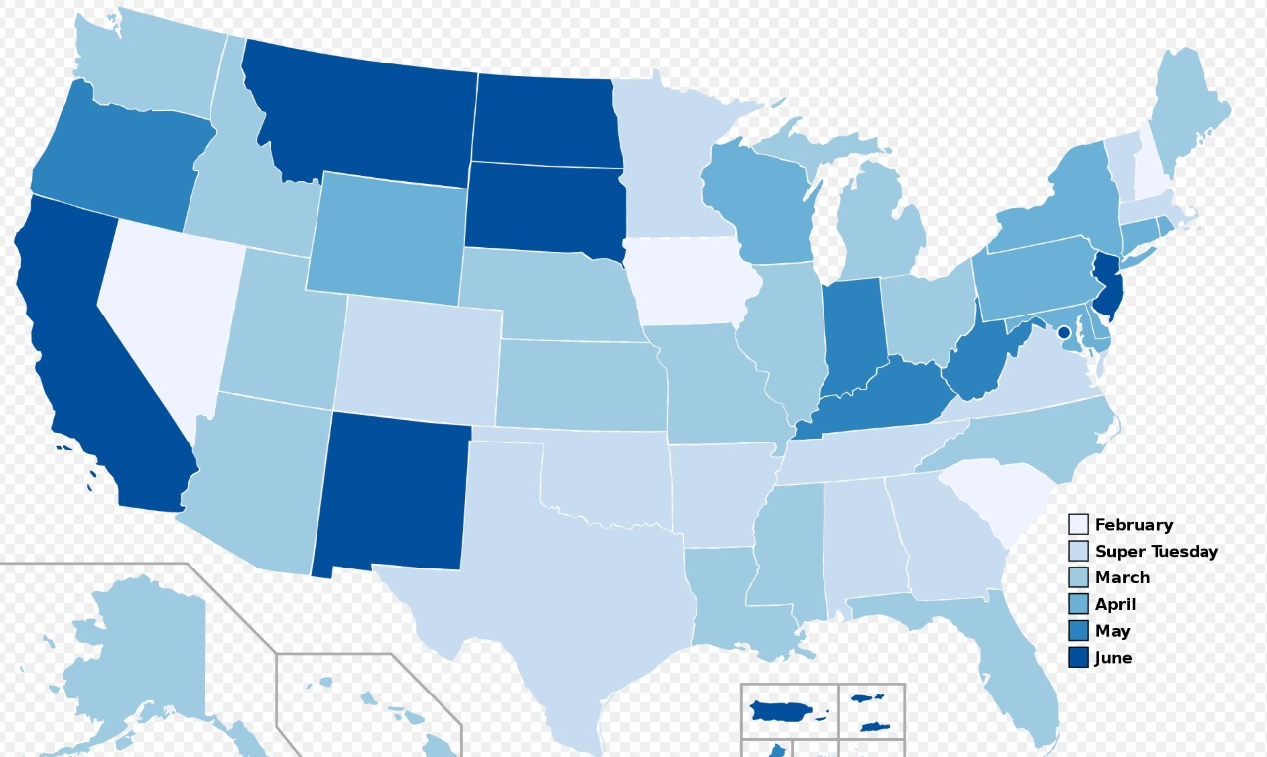
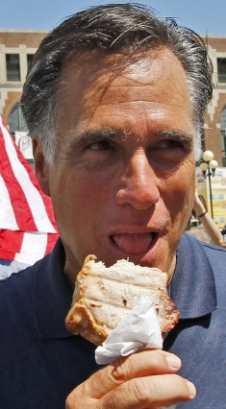
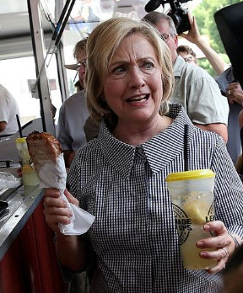

Notes:
Note, D and R presidential primary schedules are very similar. In both cases, Iowa (caucus) is first. https://en.wikipedia.org/wiki/United_States_presidential_primary
https://www.alamy.com/des-moines-iowa-usa-13th-aug-2019-pete-buttigieg-with-the-pork-chop-on-a-stick-he-bought-at-the-iowa-state-fair-buttigieg-the-mayor-of-south-bend-indiana-is-running-to-be-the-democratic-nominee-for-the-us-presidency-he-spoke-at-the-des-moines-register-political-soap-box-at-the-iowa-state-fair-and-then-toured-the-fairgrounds-iowa-has-the-first-event-of-the-presidential-selection-cycle-the-iowa-caucuses-are-february-3-2020-credit-jack-kurtzzuma-wirealamy-live-news-image264045119.html
https://politicalmurder.com/2019/08/06/forget-polls-what-will-democrats-eat-and-what-policies-will-they-tout-at-the-iowa-state-fair/
https://www.wsj.com/articles/presidential-candidates-beware-the-iowa-state-fair-11565185289
https://www.google.com/imgres?imgurl=https%3A%2F%2Fwww.orlandosentinel.com%2Fresizer%2FG9FQ3qrdfZNehcbAc7mIPikq2BI%3D%2F415x280%2Ftop%2Farc-anglerfish-arc2-prod-tronc.s3.amazonaws.com%2Fpublic%2F55OFHEYJNI3YVG2LVHQJDK2XKQ.jpg&imgrefurl=https%3A%2F%2Fwww.orlandosentinel.com%2Fopinion%2Fscott-maxwell-commentary%2Fos-op-iowa-caucus-florida-recount-hacking-scott-maxwell-20200205-pgfbihueirbgzb7lxca5hmyoni-story.html&tbnid=D8yuKHm5mKdB-M&vet=12ahUKEwjr_Z3_g-bpAhUHhKwKHeGhAOIQMygWegQIARAw..i&docid=YdBgkBY3EtgErM&w=415&h=280&q=iowa%20caucus%20politicians%20state%20fair%20pork%20chop&safe=active&ved=2ahUKEwjr_Z3_g-bpAhUHhKwKHeGhAOIQMygWegQIARAw
https://www.google.com/imgres?imgurl=https%3A%2F%2Fsi.wsj.net%2Fpublic%2Fresources%2Fimages%2FBN-JV635_IOWAFA_M_20150813121243.jpg&imgrefurl=https%3A%2F%2Fwww.wsj.com%2Farticles%2Frepublican-presidential-contenders-flock-to-iowa-state-fair-1439508432&tbnid=zBxxiMYJ89GJTM&vet=12ahUKEwjr_Z3_g-bpAhUHhKwKHeGhAOIQMygVegQIARAu..i&docid=vMa1AvJbCuHwfM&w=1280&h=853&q=iowa%20caucus%20politicians%20state%20fair%20pork%20chop&safe=active&ved=2ahUKEwjr_Z3_g-bpAhUHhKwKHeGhAOIQMygVegQIARAu

Slide 25
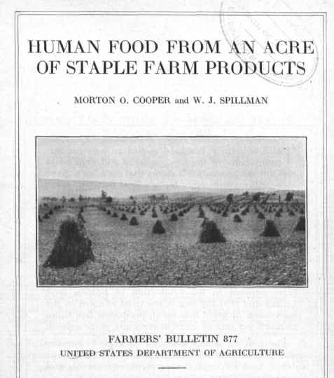
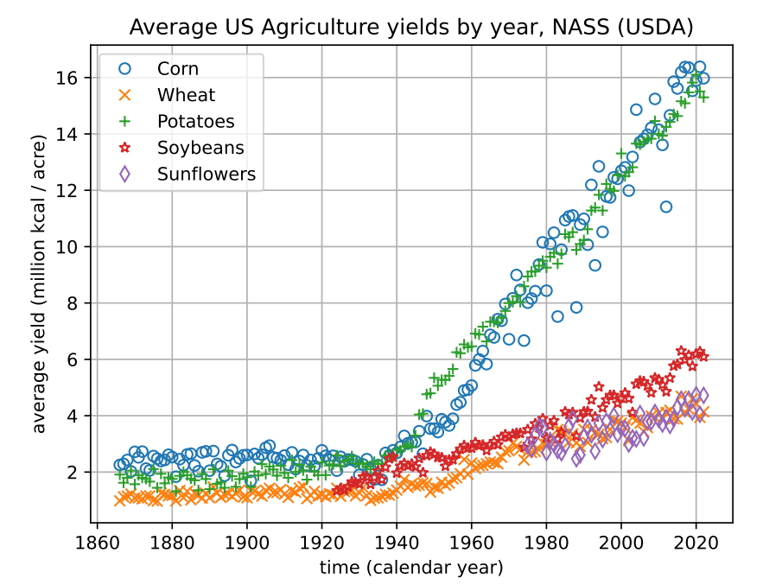
What if you want to DIY?
Notes:
1917, WWI, non-chemical horse/ox/manure-based agriculture

Slide 26
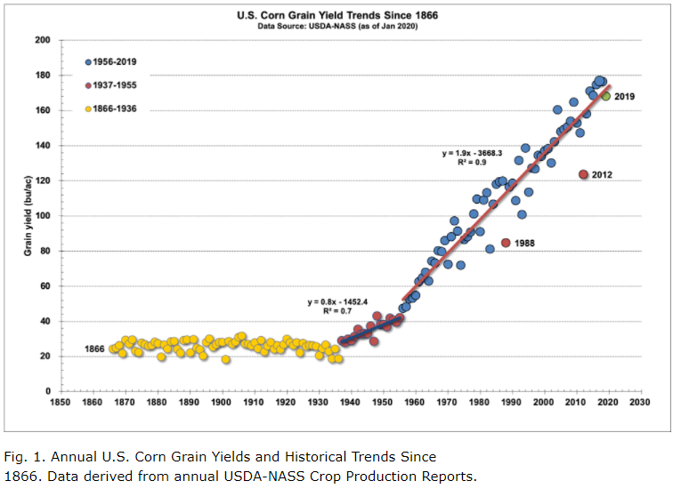
WW1
WW2
Notes:
https://www.agry.purdue.edu/ext/corn/news/timeless/YieldTrends.html

Slide 27
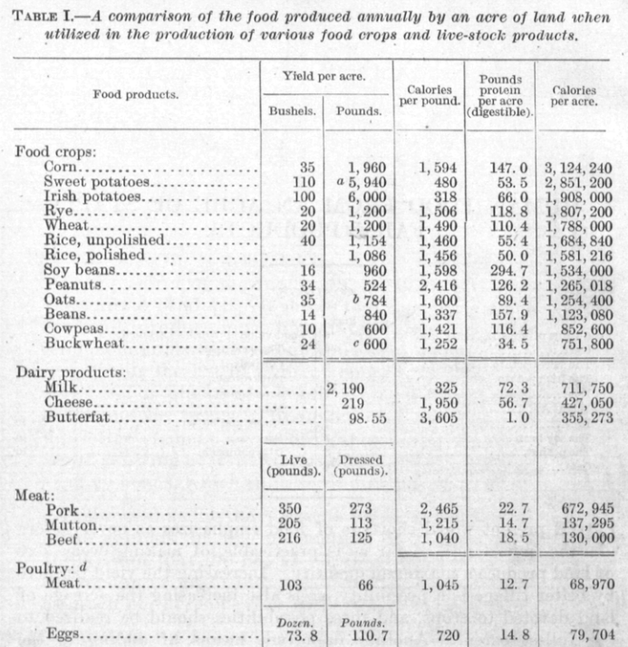
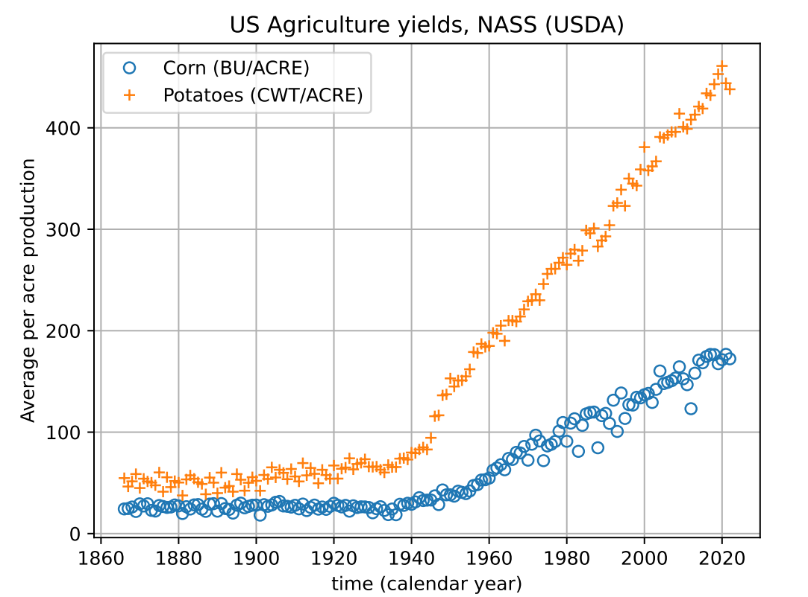
Notes:
Note the poor feed conversion efficiency of crops to meat. FYI, crickets are about 1:1 while modern “broiler” chickens are about 1.6:1

Slide 28
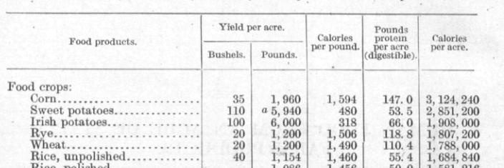
6 people, 1 year, how many acres of potatoes?
Notes:
Maybe ½ acre per person with potatoes?

Slide 29
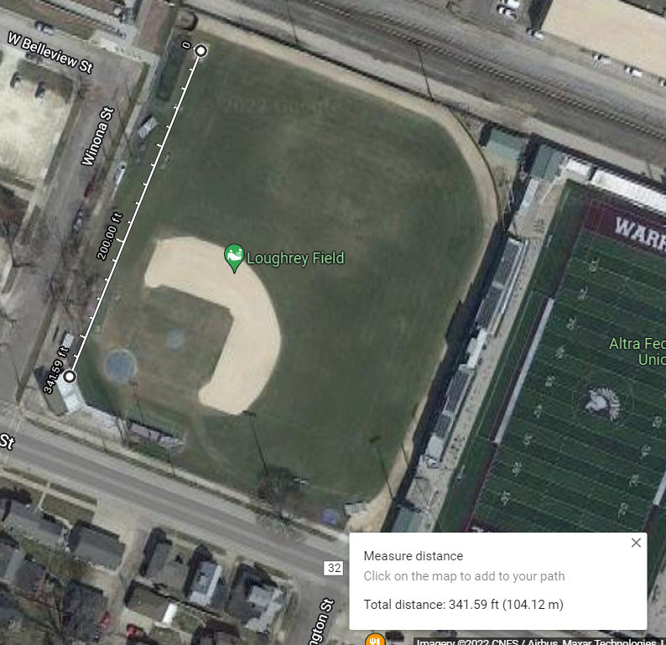






In terms of Winona 6 people need:
In 1917 “Irish” Potatoes yield $1.9M\frac{kcal}{acre}$
6ppl need $6M\frac{kcal}{year}$
So about 3 acres of potatoes

Slide 30


Can Ireland live off backyard potatoes?

Slide 31


Notes:
https://en.wikipedia.org/wiki/Demographics_of_the_Republic_of_Ireland

Slide 32








Can Ireland live off of potatoes?
~8.5M ppl in 1845 need $9.3×{10}^{12} kcal$
$84,000 km^{2}$of land, 64% arable, so $54,000km^{2}$ can be used for ag

Slide 33
Potato Crop Failures
Notes:
https://en.wikipedia.org/wiki/Demographics_of_the_Republic_of_Ireland

Slide 34
Potato Crop Failures
Famine is a political choice
Famine is a Human Disaster, not a natural disaster
Notes:
https://en.wikipedia.org/wiki/Demographics_of_the_Republic_of_Ireland

Slide 36



Related Mystery
In 1491 there were ~50M people in N. America and ~70M people in Europe. The Americans were a primarily agricultural society. What did they eat? (for 7 centuries!!!)
Tenochtitlan was 200-400k people!
Notes:
For a reference on the population estimates, see https://uwpress.wisc.edu/books/0289.htm
Graph from https://en.wikipedia.org/wiki/Population_history_of_indigenous_peoples_of_the_Americas

Slide 37


Slide 38



Related Mystery
In 1491 there were ~50M people in N. America and ~70M people in Europe. The Americans were a primarily agricultural society. What did they eat? (for 7 centuries!!!)
Notes:
For a reference on the population estimates, see https://uwpress.wisc.edu/books/0289.htm
Graph from https://en.wikipedia.org/wiki/Population_history_of_indigenous_peoples_of_the_Americas

Slide 39


Notes:
“Chinampas were essentially man-made islands, raised bed gardens on the surface of Lake Texcoco’s shallow waters.”
https://www.historyonthenet.com/aztec-agriculture-floating-farms-fed-the-people
https://en.wikipedia.org/wiki/Chinampa

Slide 40

16,000 acres @ 38bu/acre would feed 100,000 people
Notes:
“Chinampas were essentially man-made islands, raised bed gardens on the surface of Lake Texcoco’s shallow waters.”
https://www.historyonthenet.com/aztec-agriculture-floating-farms-fed-the-people
https://en.wikipedia.org/wiki/Chinampa

Slide 41
Sadly, Professor Moore is the only survivor of a plane crash in Alaska. Fortunately, the crash is adjacent a mountain stream that’s filled with trout. From a map in the survival kit, he estimates that the hike downstream will take 5 days.
Should he (a) start hiking immediately,
or (b) spend a week catching and smoking trout so that he’ll have food to eat while on the hike.
There are ripe wild berries along the path.
Information: 1 trout contains about 120 Calories of food energy; 1 lb of raspberries contains 240 Calories; Prof Moore is overweight at 22% body fat, or ~18kg of body fat. Human body fat contains about 3500 Calories per pound.

